Slide 1
Human Pose Detection
- Harshitha Polsani, Venkata Ramya Vardineni, Anusha Yarrasani
Human pose detection is a computer vision technique used to detect and identify human joints or key points in images.
It involves analyzing the spatial arrangement of various body parts, such as the head, arms, and legs, and estimating their relative positions.
The objective of Human Pose Detection is to generate a set of keypoints that accurately represent the pose of a human.
These key points can be used in various applications such as motion recognition, virtual testing, fitness tracking and monitoring.

Slide 2
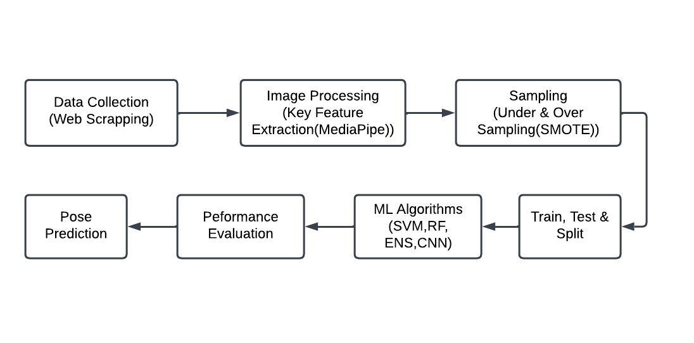
Methodology:

Slide 3
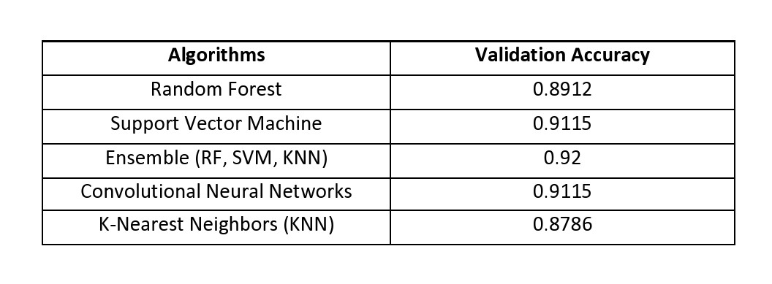
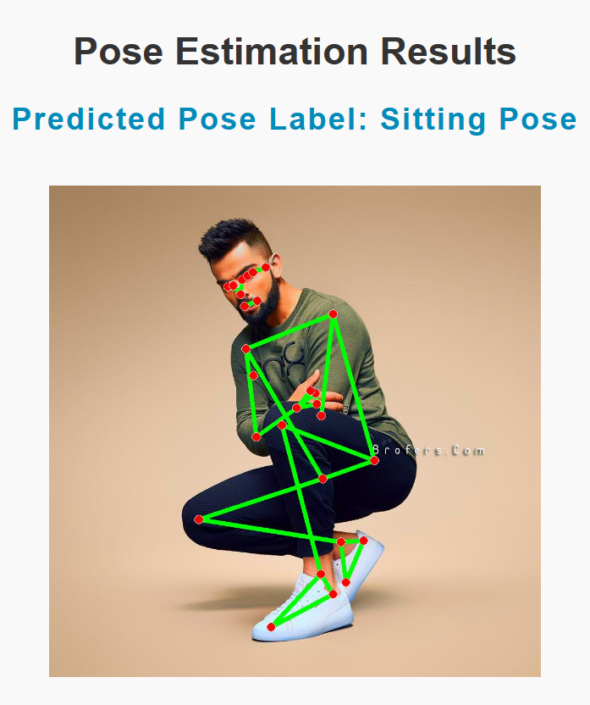
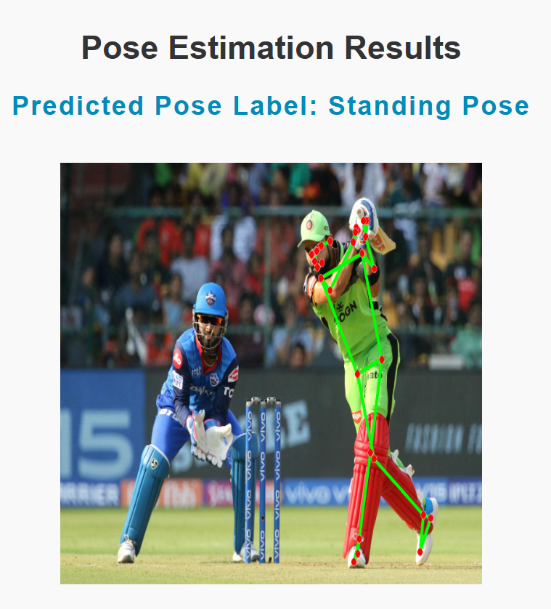
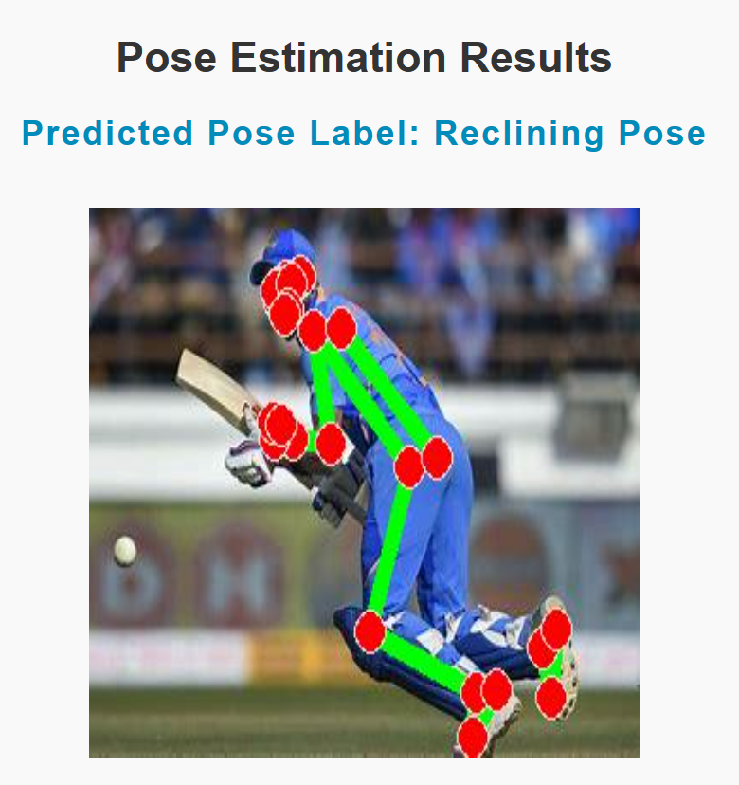
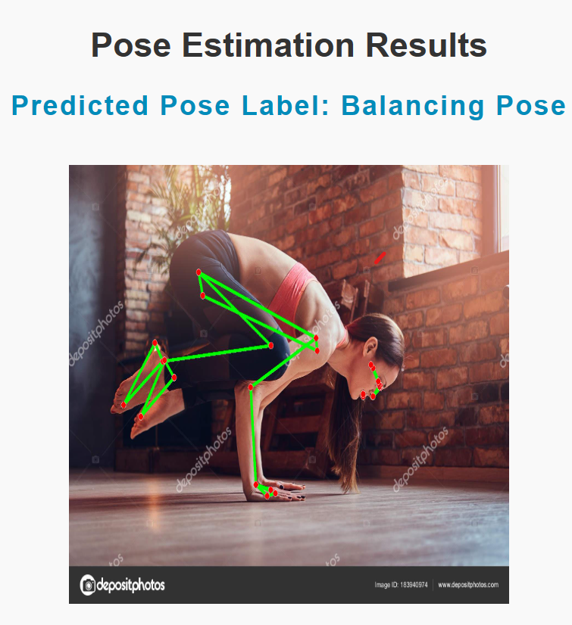
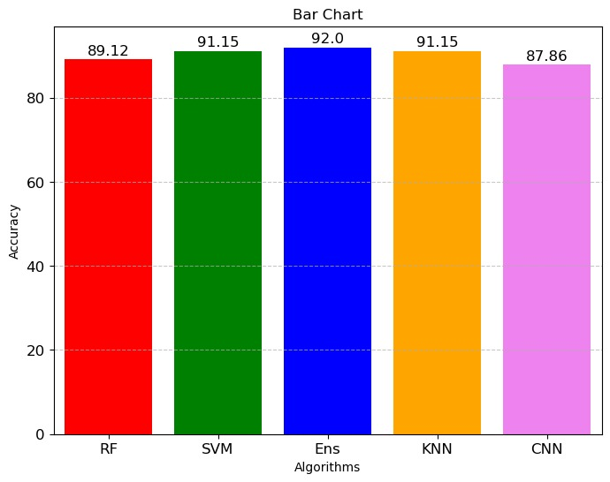
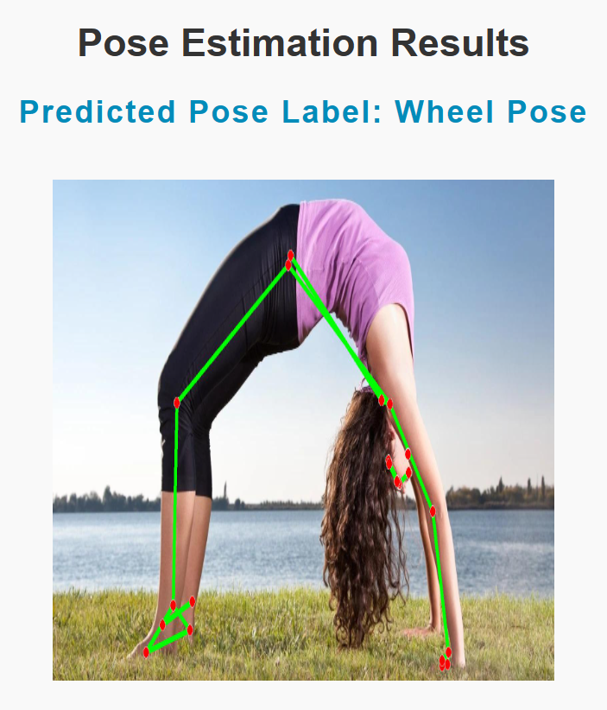
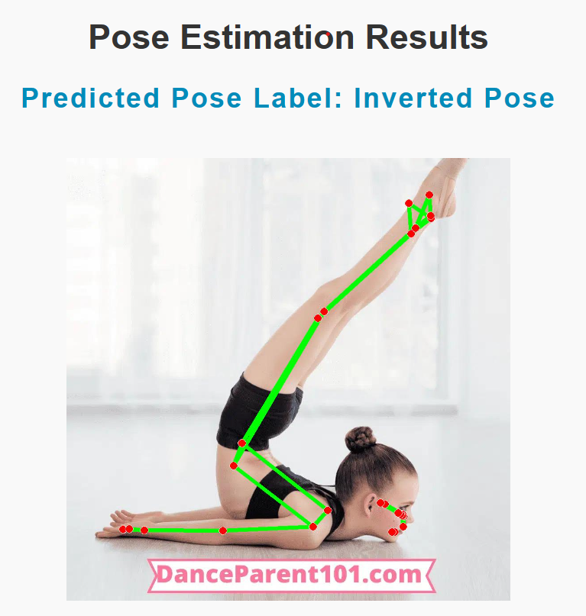
Experimental Results:

Slide 4
References:
“Yoga-82: A New Dataset for Fine-grained Classification of Human Poses”, Manisha Verma, Sudhakar Kumawat, Yuta Nakashima, Shanmuganathan Raman, in ARXIV, 2020.
“Yoga Pose Detection and Correction using Posenet and KNN”, Varsha Bhosale, Pranjal Nandeshwar, Abhishek Bale, Janmesh Sankhe, in IRJET, 2022.
“Yoga Pose Classification Using Deep Learning,” Shruti Kothari, Robert Chun, Katerina Potika, and Susmit Gaikwad.
“Yoga Pose Estimation and feedback Generation Using Deep Learning,” Vivek Anand Thoutam, Anugrah Srivastava, Tapas Badal, Vipul Kumar Mishra, G. R. Sinha, Aditi Sakalle, Harshit Bhardwaj, and Manish Raj. in PMC, 2022.
“Real-time Human Pose Estimation from Video with Convolutional Neural Networks,” Marko Linna, Juho Kannala, and Esa Rahtu. in ARXIV, 2016.

